Slide 1
Vorlesung Kontextsensitive Systeme
- Near Realtime Systems-

Slide 2
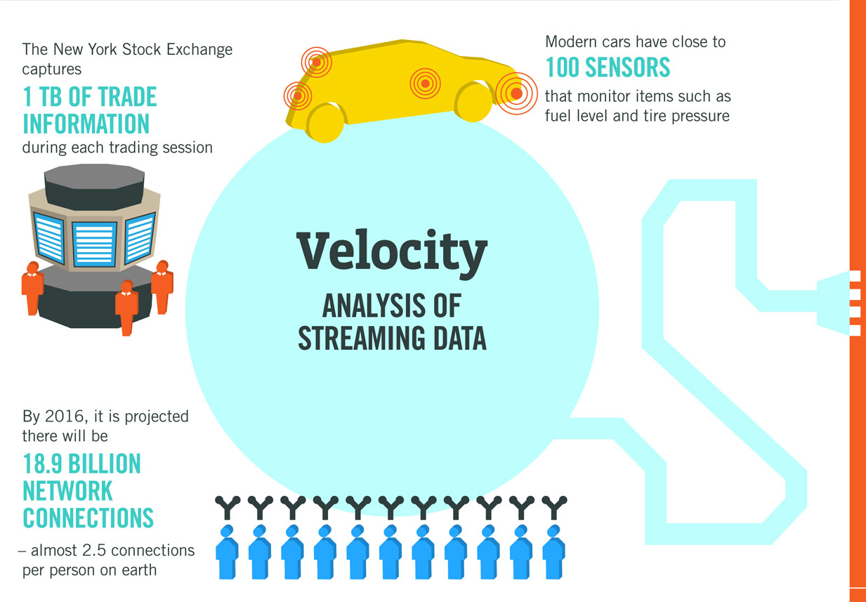

Slide 3
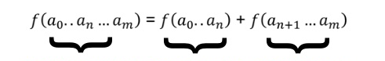
query = function (all data)
query
batch
realtime
Lambda Architecture splits realtime and batch tasks
e.g CSS = Offline Learning + Realtime Classification
Batch Layer Hadoop
Realtime Processing

Slide 4
Business Velocity Is Key to Efficiency → Context Sesitivity
mail express fax e-mail Document transfer
Business
Requirement
100 ms
20 ms
Algorithmic trading
Reduce
processing time
20 min
30 sec
Airline operations
Design Strategy
8 hr
10 sec
Call center inquiries
STP, zero-latency enterprise
1 day
5 min
Track financial position
1 day
15 min
Supply chain updates
3 days
1 min
Phone activation
1 week
0.5 hour
Refresh data warehouse
5 days
2 hrs.
Trade settlement
4 weeks
1 day
Build-to-order PC
Typical Business SLAs 10⁶ 10⁵ 10⁴ 10³ 100 10 1 0 Seconds
Notes:
Strategic Imperative: Companies must continuously find ways to speed up their business to respond to customer demands and competitive pressures.
The Business Pipeline
Pipeline Velocity is Accelerating in all businesses
E.g.
Financial Trading is 10x the volume of 5yrs ago
SLAs on most manufacturing is half what it was 10 years ago
Virtually all retail fulfillment is next day ship… remember “allow 4-6 weeks for delivery”? It wasn’t that long ago.
Note’s from Roy’s presentation:
Many business managers are focused on reducing the time it takes to execute their business processes and activities. Speed underlies many modern management strategies, including the zero-latency enterprise (ZLE), "time-based competition," straight-through processing (STP), and "just in time" inventory (note that real-time enterprise and event-driven enterprise generally are synonyms for ZLE). When an order is placed online, the expectation is that the goods will arrive "faster" than in the past. When someone applies for an insurance policy or submits a claim, he or she expects a quicker decision and more visibility into the process. These expectations require remaking supply, distribution, service and marketing infrastructures. A classic example of increased business velocity can be found in PC manufacturing. The entire process — talking to the customer, configuring a system, manufacturing, testing, shipping and transferring funds from the customer's bank account — takes less than 24 hours (in some cases). Short "quote to cash" cycle times require fast, closely knit applications, often implemented using EDA, with or without BPM.
Action Item: Business managers and analysts must identify which of their business processes should be accelerated to produce meaningful improvements in business results. Not all processes need to run fast.

Slide 5
Knowing Sooner Rather than Later (Hackathorn, 2007)
→ CSS in Business = Realtime Business Analytics
Hackathorn
Realtime data processing at massive scale is becoming a requirement for businesses
Context-aware online advertising, real-time search, high frequency trading, social networks
Have a stream of events that flow into the system at a given data rate

Slide 6
Complex Event Systems
Querying for Event and Timeseries Systems:
Event-pattern detection
Event filtering
Event aggregation and transformation
Modeling event hierarchies
Event abstraction
Detecting relationships (such as causality, membership or timing) between events
Abstracting event-driven processes

Slide 7
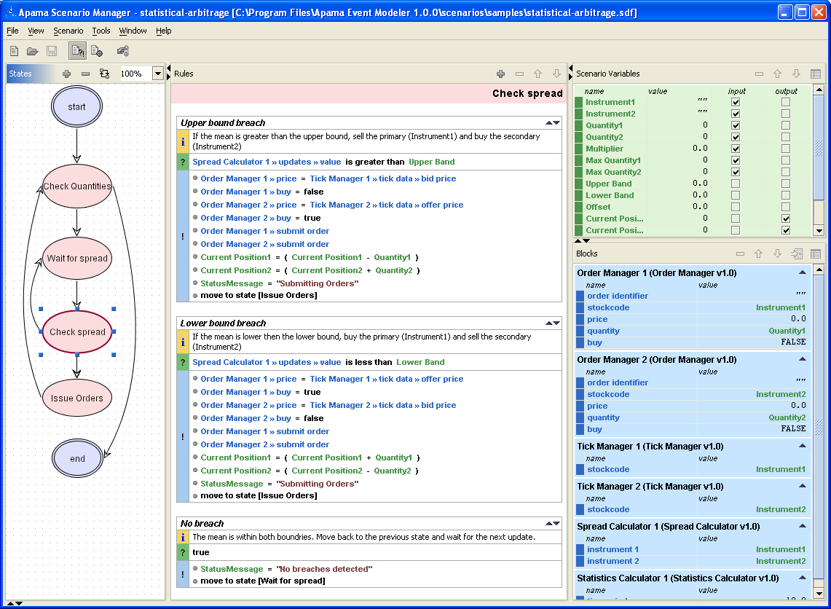



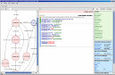
Event analysis
Event based scenarios can be modelled using a GUI tool.
Business analysts can develop, configure and deploy scenarios themselves
Scenario modelling
Smart Block Analytics
Integration
Middleware
DBMS
Point Systems
Other…

Slide 8
Why Real Time Stream Processing for Big Data?
Scale out needed also for Event Processing
Very diverse analysis challenges (programming framework needed)
The processing system must keep up with the event rate or degrade gracefully by eliminating events, this is typically called load shedding
MapReduce, Hadoop, etc. store and process data at scale, But not for realtime systems
There's no hack that will turn Hadoop into a real realtime streaming system
can reduce latency in Hadoop systems and get similar effects
but fundamentally different set of requirements than batch processing
Lack of a "Hadoop of realtime" has become the biggest hole in the data processing ecosystem

Slide 9
Cloud Streaming Engines
Twitter (Backtype) Storm
Open Source
Yahoo S4
Open Source
Facebook Puma
Not Open Sourced yet, will be soon
Spark Streaming
Up and coming!?
SAP Sybase Event Stream Processor
Older non-cloud systems
IBM System S
Borealis
Decendent of Aurora from Brown Univ., Not active anymore
Notes:
Borealis by Daniel Abadi et al. He graduated from MIT and is now a professor at Yale, but is not working on Borealis anymore.

Slide 10
Streaming Analysis
Non-trivial parallel stream processing algorithm with novel global synchronization and cluster-delta data transfer to achieve scalability
Clustering of social media streams: real-time processing of 10% Twitter (“Gardenhose”)
Recent progress in learning data representations and similarity metrics
High-dimensional vectors: textual and network information
Expensive similarity computation: 43.4 hours to cluster 1 hour’s data with sequential algorithm
Online K-Means with sliding time window and outlier detection
Group tweets as protomemes: hashtags, mentions, URLs, and phrases
Xiaoming Gao, Emilio Ferrara, Judy Qiu. Parallel Clustering of High-Dimensional Social Media Data Streams. To appear at 15th IEEE/ACM International Symposium on Cluster, Cloud and Grid Computing (CCGRID 2015).

Slide 11
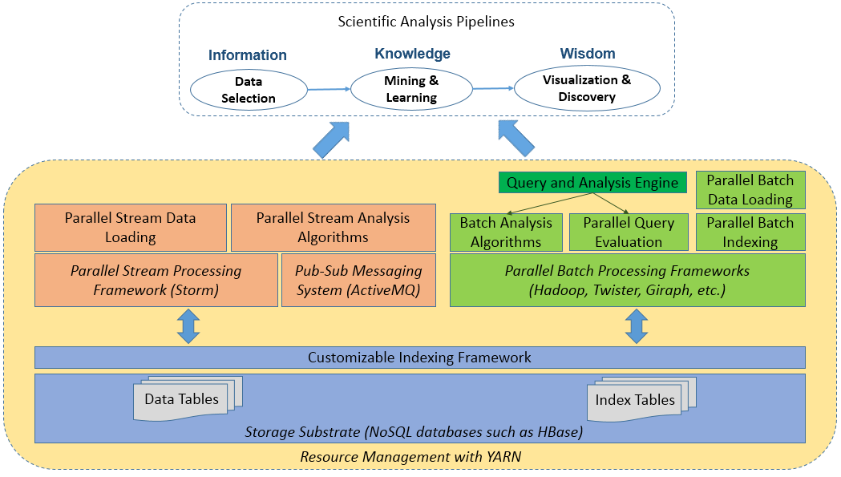
Batch and Streaming Analysis for Social Media Data
Streaming analysis module
Batch analysis module
Storage substrate
(Source: Judy Qiu,Indiana University)

Slide 12
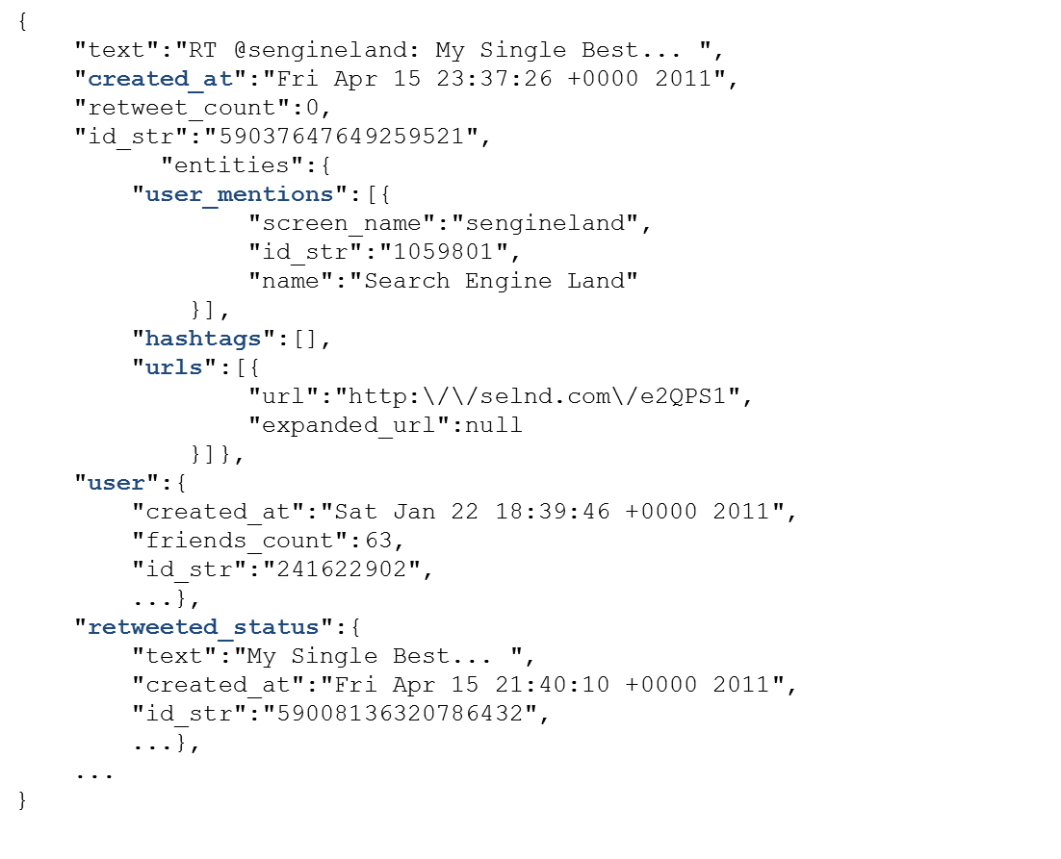
Social media data – an example data record

Slide 13
Parallelization with Storm - challenges
DAG organization of parallel workers: hard to synchronize cluster information
Sparsity of high-dimensional vectors make any synchronization expensive
Data point 1:
Data point 2:
Content_Vector: [“step”:1, “time”:1, “nation”: 1,
“ram”:1]
Diffusion_Vector: …
…
Content_Vector: [“lovin”:1, “support”:1, “vcu”:1,
“ram”:1]
Diffusion_Vector: …
…
Centroid:
Content_Vector: [“step”:0.5, “time”:0.5, “nation”: 0.5, “ram”:1.0, “lovin”:0.5,
“support”:0.5, “vcu”:0.5]
Diffusion_Vector: …
…
Cluster
Cluster-delta synchronization strategy reduces message traffic and synchronization overhead

Slide 14

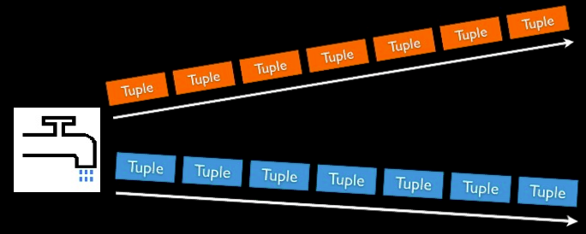
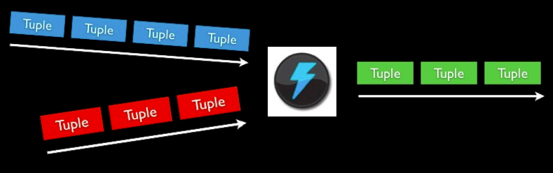
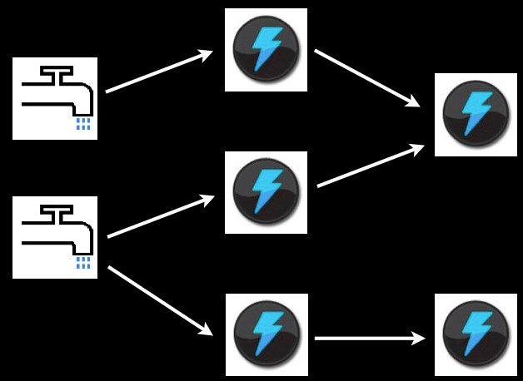
Storm Concepts
Streams
Unbounded sequence of tuples
Spout
Source of Stream
E.g. Read from Twitter streaming API
Bolts
Processes input streams and produces new streams
E.g. Functions, Filters, Aggregation, Joins
Topologies
Network of spouts and bolts

Slide 15
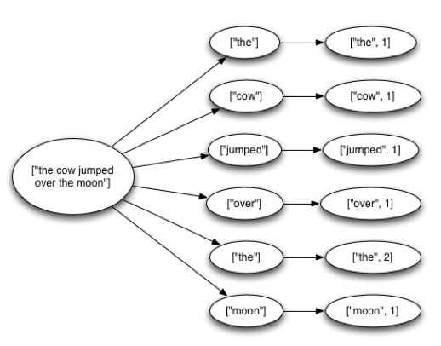
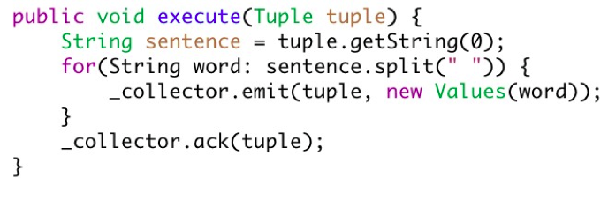
Guaranteeing Message Processing
Tuple Tree →
A spout tuple is not fully processed until all tuples in the tree have been completed
If the tuple tree is not completed within a specified timeout, the spout tuple is replayed
Reliability API for the user:
“Anchoring” creates a new edge in the tuple tree
Marks a single node in the tree as complete

Slide 16
Solution – enhanced Apache Storm topology
Worker Process
ActiveMQ
Broker
Clustering Bolt
SYNCINIT
CDELTAS
…
Clustering Bolt
Protomeme Generator Spout
…
PMADD
OUTLIER
SYNCREQ
Synchronization Coordinator Bolt
tweet stream
Worker Process
Clustering Bolt
…
Clustering Bolt
Bootstrap Information
Sequential or Parallel Batch Clustering Algorithm

Slide 17
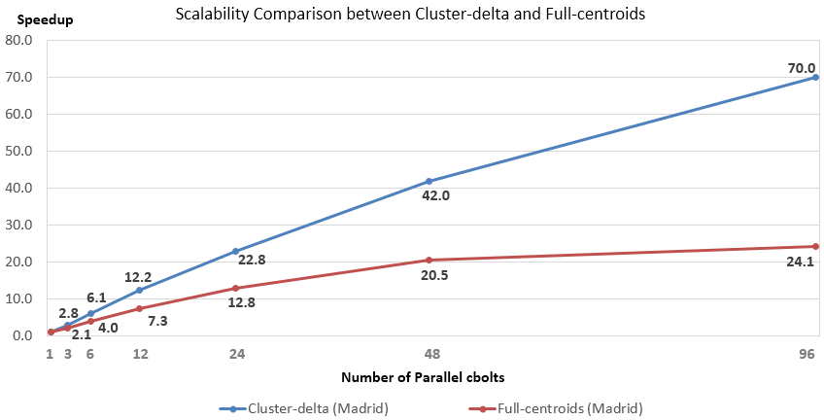
Scalability comparison
1 hour’s data for testing, first 10 mins for bootstrap
33 mins to process 50 mins’ data (better than real time) with Cluster-delta method due to decreased message sizes compared to full-centroid approach

Slide 18
Why frameworks?
Multiple use cases
Processing, computation, etc.
Data types, size, velocity
Scalability
Mission critical data
Fault-tolerance
Time series / pattern analysis
Reliability

Slide 19
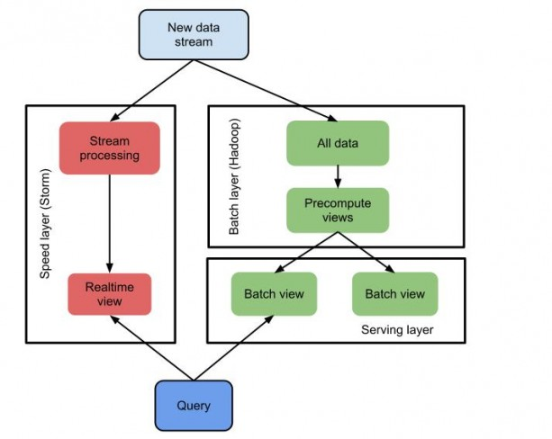
Realtime Views
Serving Layer (e.g. HANA)

Slide 20
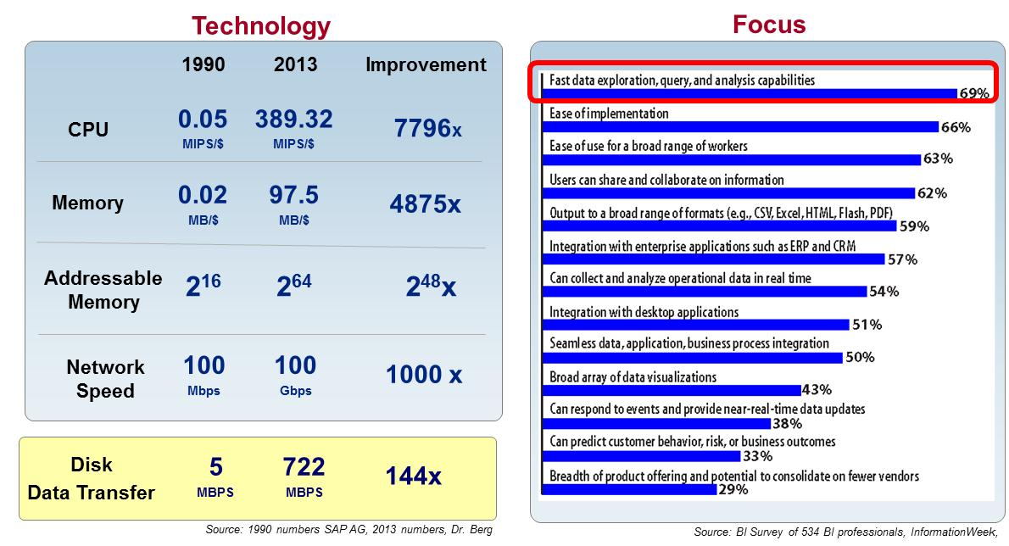
What is Holding us Back?
Disk speed is growing slower than all other hardware components, while the need for speed is increasing

Slide 21
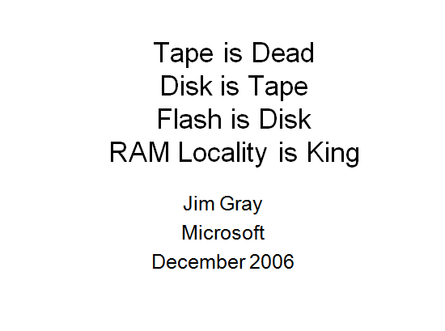
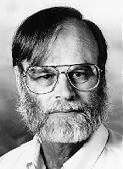
Die technologische Entwicklung verschiebt die Grenzen in der IT.
“Bis 2012 werden 70% der größten 1000 globalen Unternehmen granulare Detailinformationen hauptsächlich Hauptspeicher-basiert verarbeiten, um die BI-Anwendungsperformance zu optimieren.”
(Gartner)

Slide 22
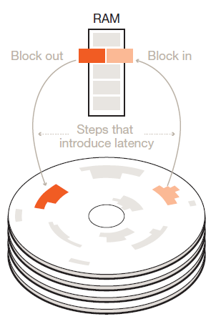
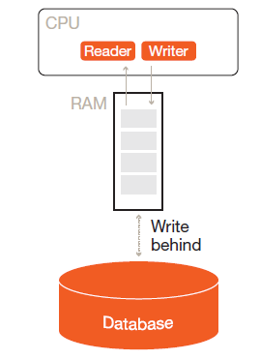
Performance Bottleneck Comparison
Without high-capacity RAM
Database stored on disk
Bottleneck: Latency between disk and RAM
With high-capacity RAM
Database stored in memory
Bottleneck: Latency between CPU and RAM
Orders of magnitude response time improvements
Image Source:Morrison, A. (2012). The art and science of new analytics technology. PwC Technology Forecast, 1, 31-43. Retrieved from http://www.pwc.com/en_US/us/technology-forecast/2012/issue1/features/feature-art-science-analytics-technology.jhtml
Notes:
BI applications have always faced the challenge of satisfactory performance in the face of growing data volumes. In-memory computing reduces latency by removing the bottleneck between disk storage and RAM. The new bottleneck to be optimized is between CPU and RAM. This results in response times that are orders of magnitude faster.

Slide 23
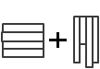
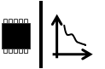

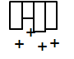
Jetzt ist die Zeit für die Umsetzung der In-Memory-Innovation.
Hardware-Innovationen
SW-Innovationen
Multi-Core Architektur (8 x 8core CPU pro Server)
Massive Parallelskalierung durch zahlreiche Knoten möglich
Verbesserung RAM-Lokalität
Zeilen- und Spaltenablage
Komprimierung
Partitionierung
64bit-Adressraum – 2TB in aktuellen Servern
100GB/s Datendurchsatz
Starker Rückgang Preis/Performance
Keine zusätzlichen Aggregationen
Nur Einfüge-Operationen
In-Memory Data Management ermöglicht die Verarbeitung sehr großer Datenmengen im Hauptspeicher . Ergebnisse aus Analysen und Transaktionen stehen dadurch in Echtzeit zur Verfügung.

Slide 24
Querying near Realtime
HANA pushes parts of Business Analytics to Realtime
Before HANA:
Datawarehouses Analytics (with precalculated features)
„Fast Analysis of Shared Multidimensional Information“ (FASMI)
Online Analytical Processing (OLAP)
OLAP Cube
multidimensional representation of data fit for analysis
Typically independent of Online Transaction Processing
Promise of In-Memory→Combination of OLAP and OLTP
Analysis can be build into transactions
→Context sensititive systems

Slide 25
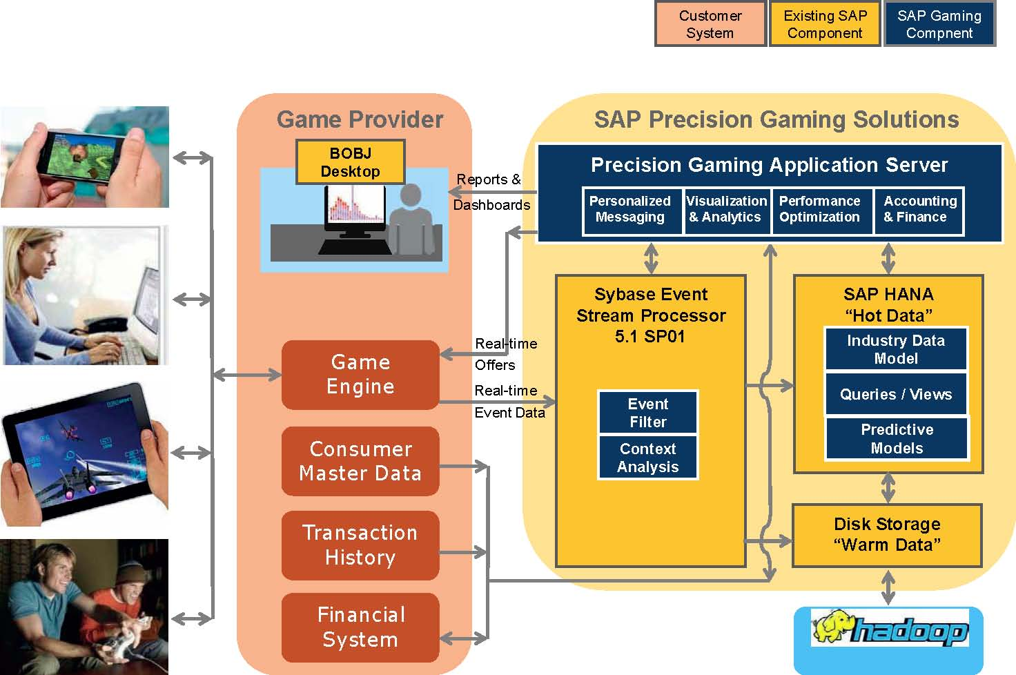
Example Game-Analytics

Slide 26
A Context Processing Chain

Slide 27
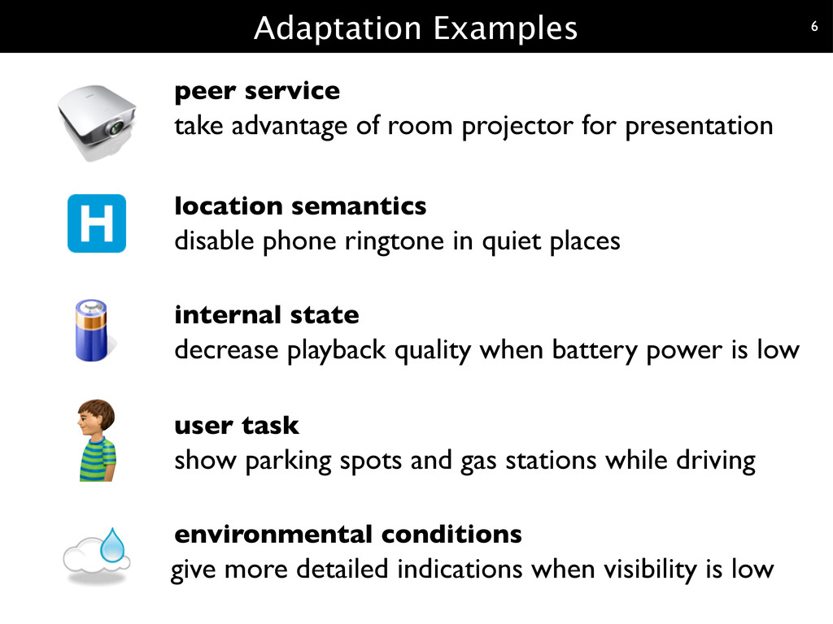
Source: https://released.info.ucl.ac.be/projects/varibru/solution.html

Slide 28
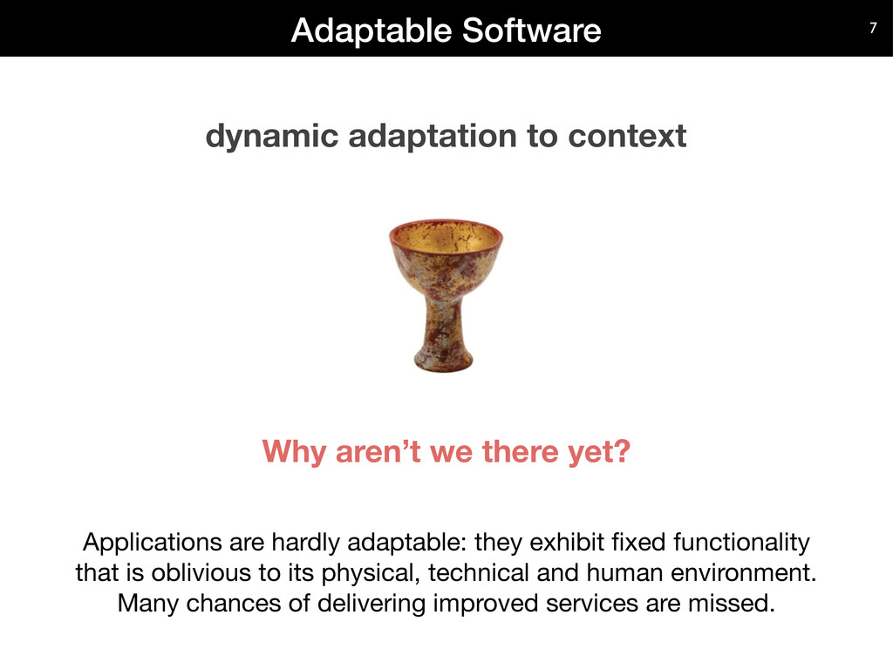
Source: https://released.info.ucl.ac.be/projects/varibru/solution.html

Slide 29
Context-Awarene Application (Recap: Schilit)
Proximate Selection
A user interface technique where the contextually-relevant objects are emphasized or otherwise made easier to choose
Automatic Contextual Reconfigurations
Rewiring components and presentation based on context
Contextual Information and Commands
Produce different results according to the context in which they are issued
Context-Triggered Actions
Context-triggered actions are simple IF-THEN rules used to specify how context-aware systems should adapt

Slide 30
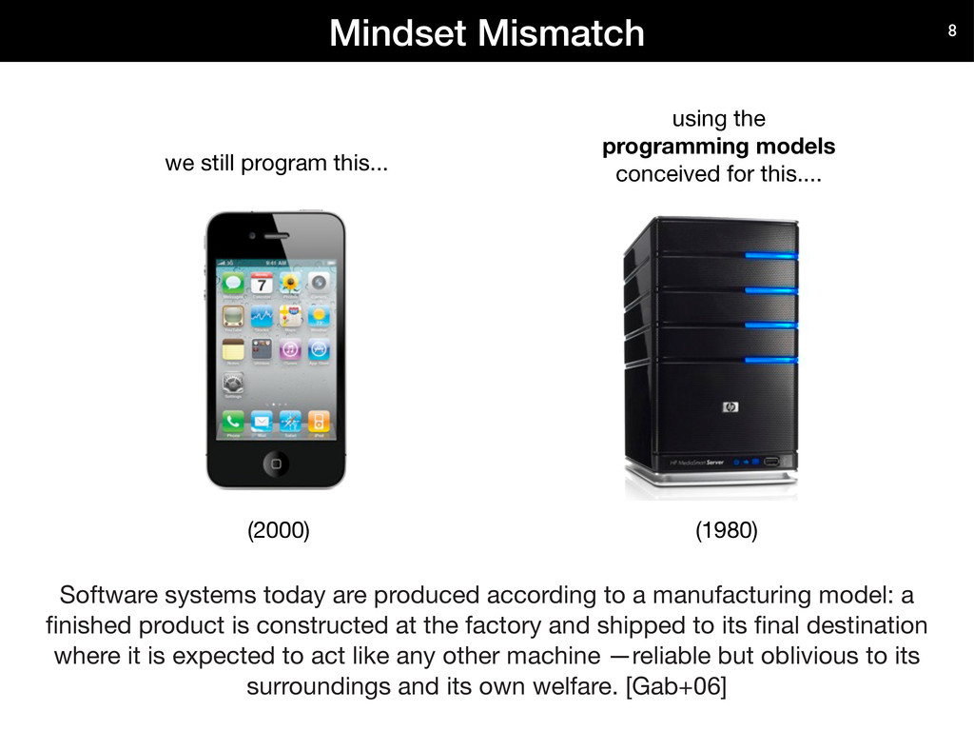
Source: https://released.info.ucl.ac.be/projects/varibru/solution.html

Slide 31
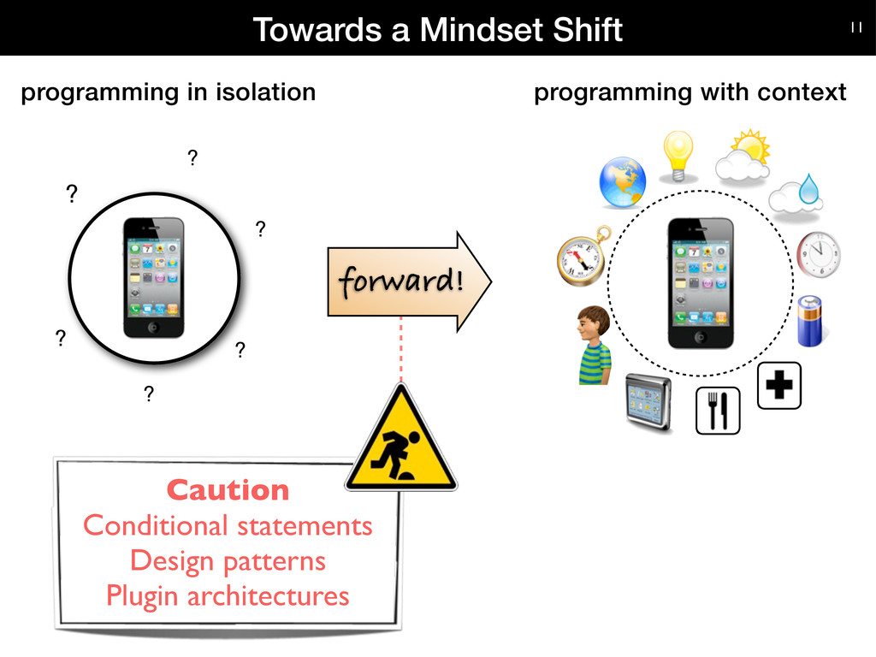
Source: https://released.info.ucl.ac.be/projects/varibru/solution.html

Slide 32
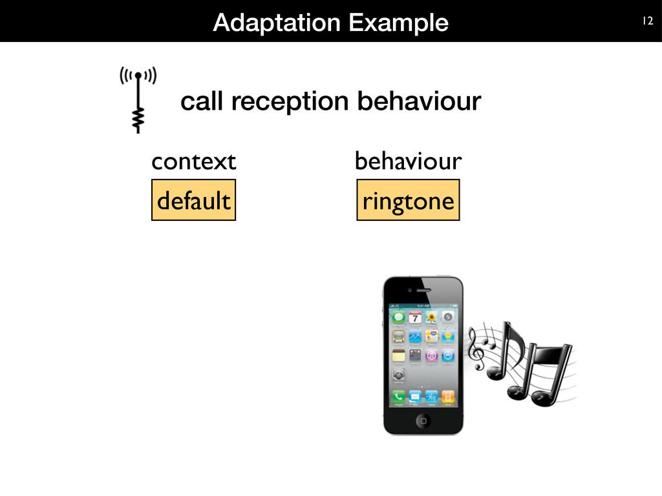

Slide 33
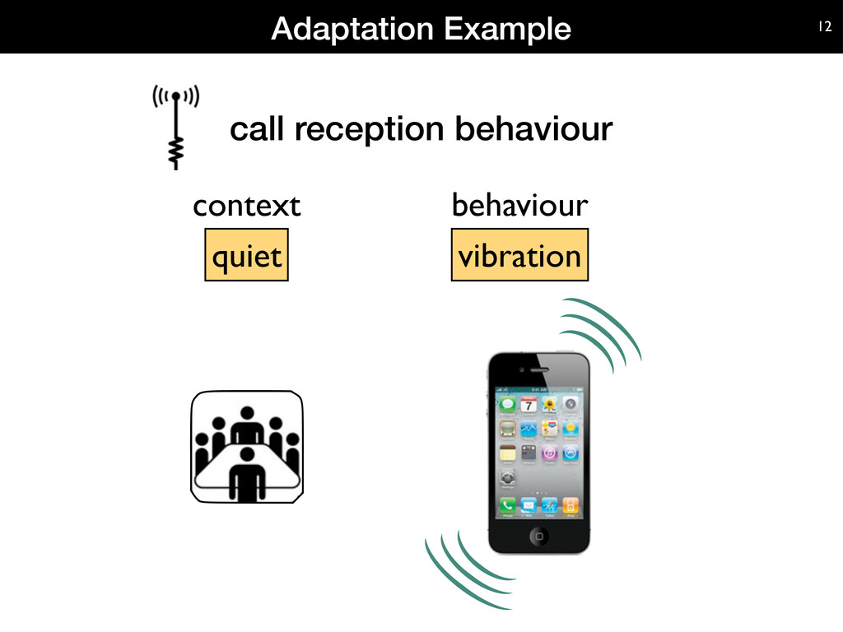
Source: https://released.info.ucl.ac.be/projects/varibru/solution.html

Slide 34
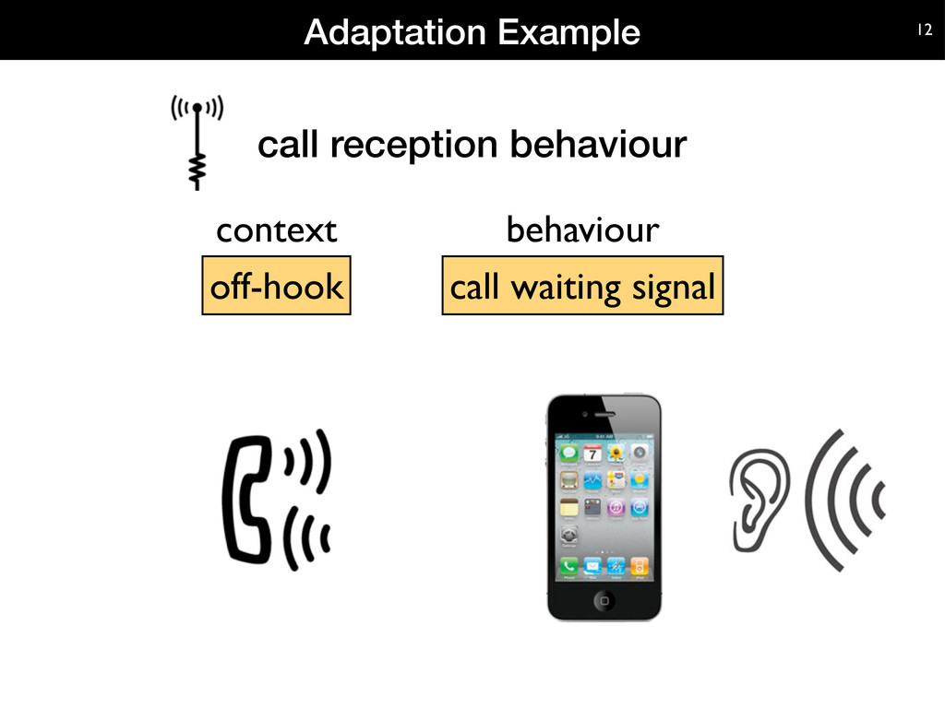
Source: https://released.info.ucl.ac.be/projects/varibru/solution.html

Slide 35
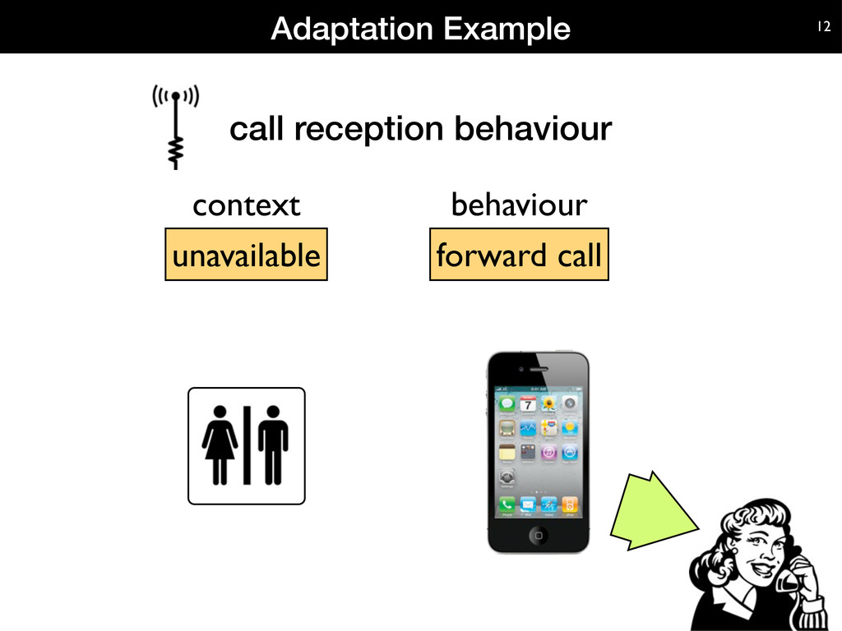
Source: https://released.info.ucl.ac.be/projects/varibru/solution.html

Slide 36
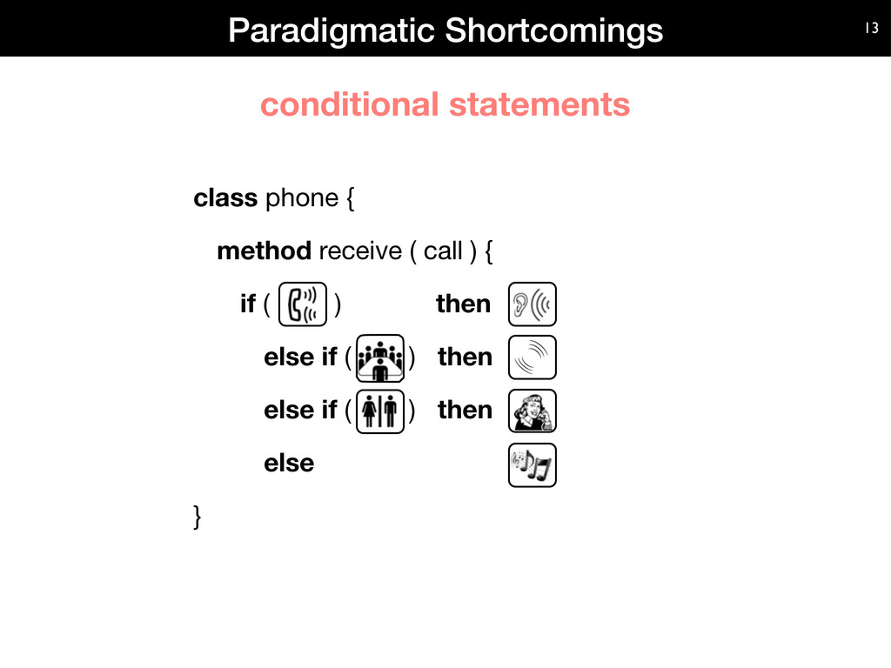
Source: https://released.info.ucl.ac.be/projects/varibru/solution.html

Slide 37
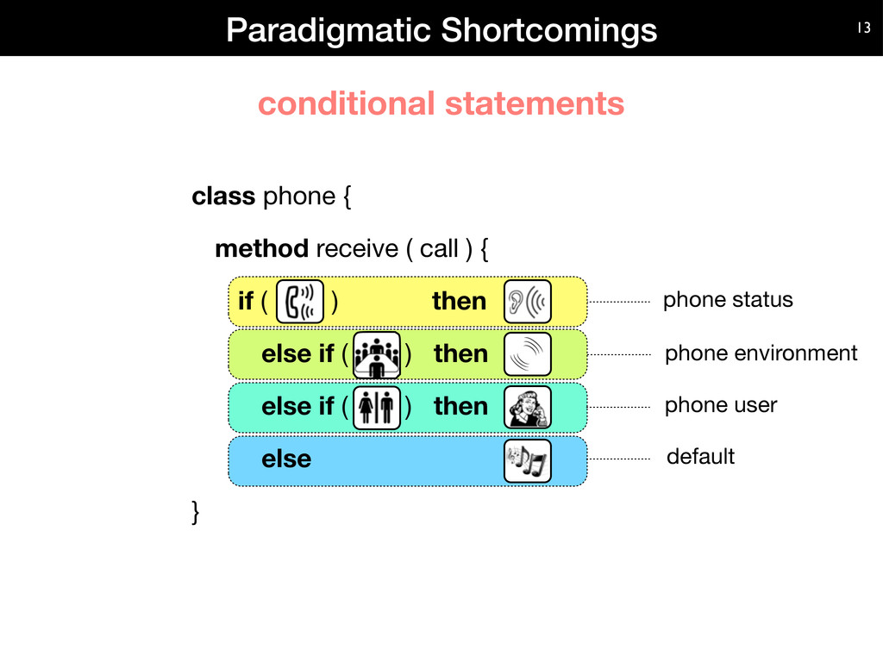
Source: https://released.info.ucl.ac.be/projects/varibru/solution.html

Slide 38
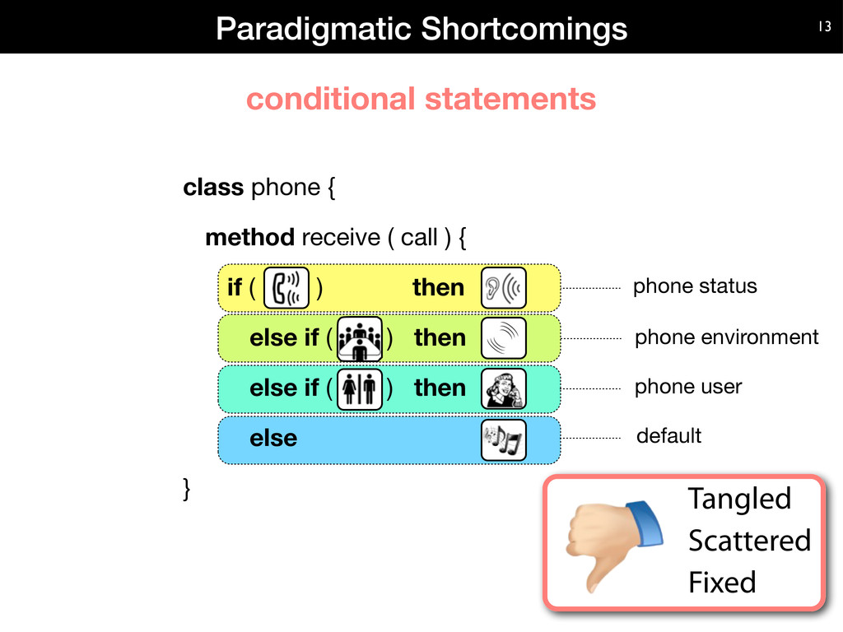
Source: https://released.info.ucl.ac.be/projects/varibru/solution.html

Slide 39
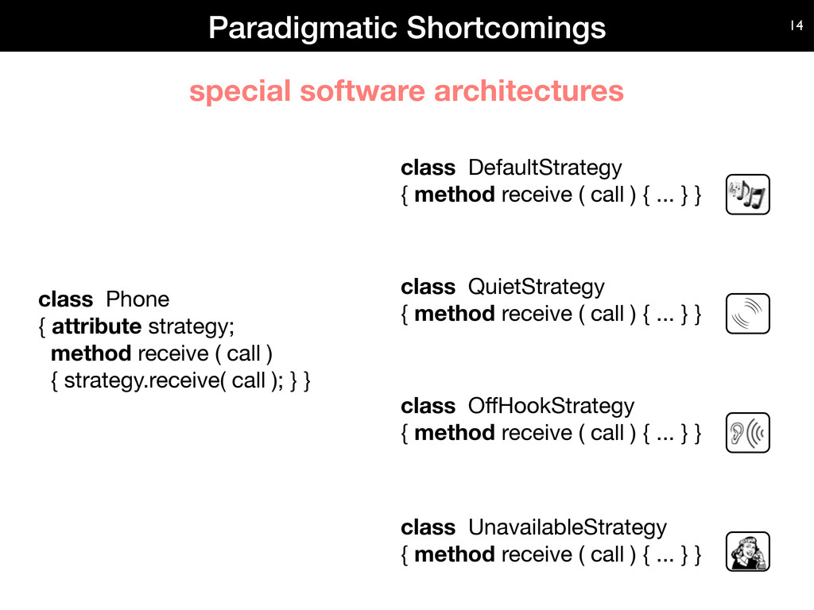
Source: https://released.info.ucl.ac.be/projects/varibru/solution.html

Slide 40
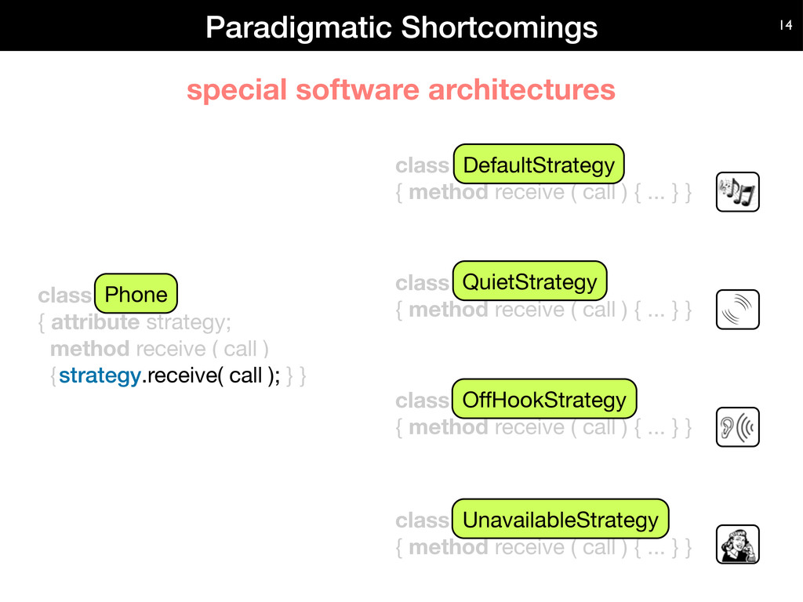
Source: https://released.info.ucl.ac.be/projects/varibru/solution.html

Slide 41
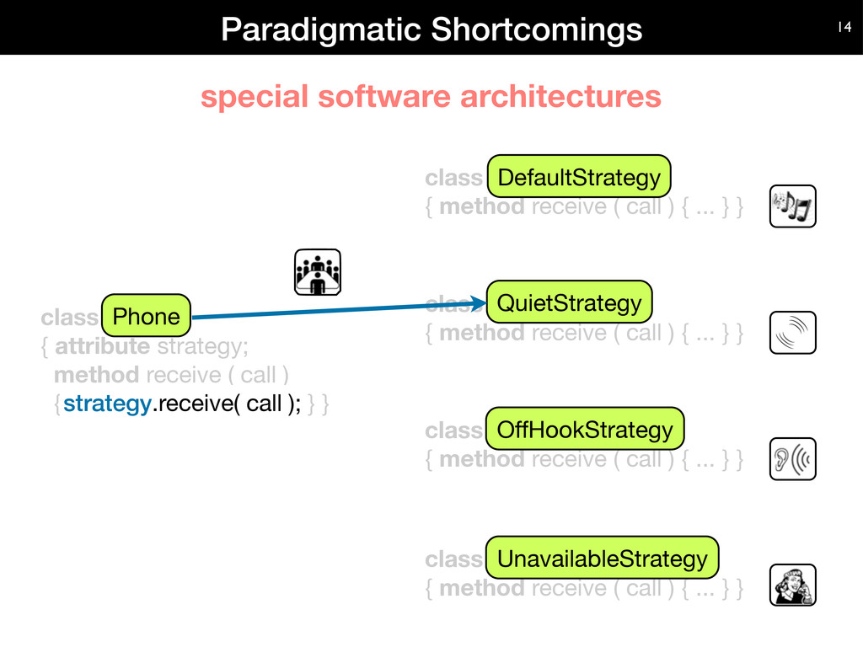

Slide 42
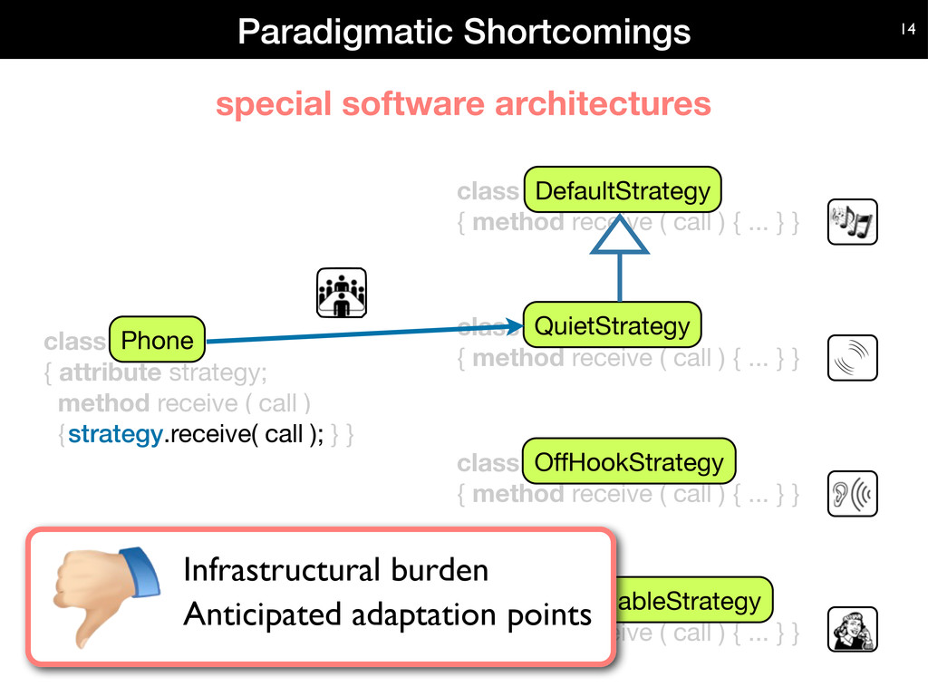
Source: https://released.info.ucl.ac.be/projects/varibru/solution.html

Slide 43
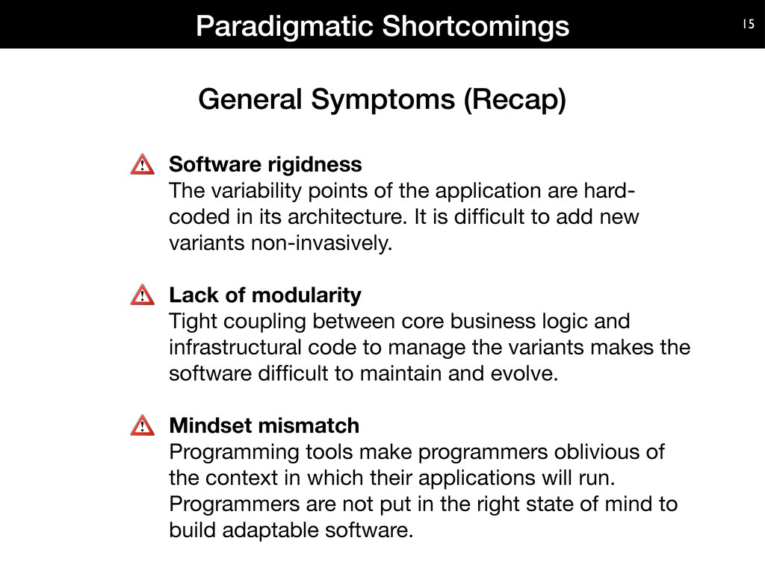

Slide 44
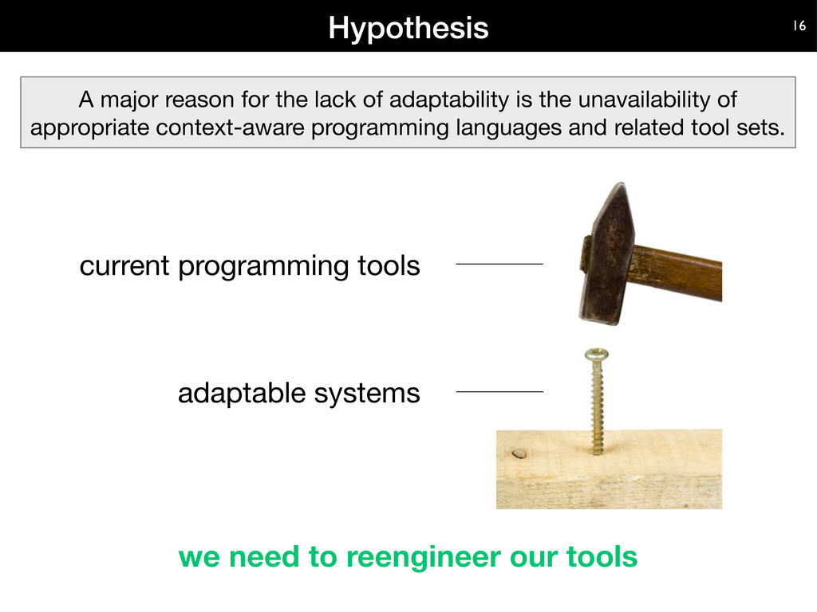

Slide 45
Extending OOP
Aspect vs. Feature vs. Context oriented Programming

Slide 46
COP Basics

Slide 47
COP Design Concepts
Context group as collection of environmental situations sharing the same characteristics
Context represents a single environmental situation in a group
Context group
Context
Context
Notes:
We claim that our design concepts inspired by COP can significantly simplify the software developing process for WSN. It is worth noticing, that these concepts are language independent and can be implemented in any of them.

Slide 48
Wildlife Tracking Design
Notes:
It is not stand alone func, but supports another func.

Slide 49
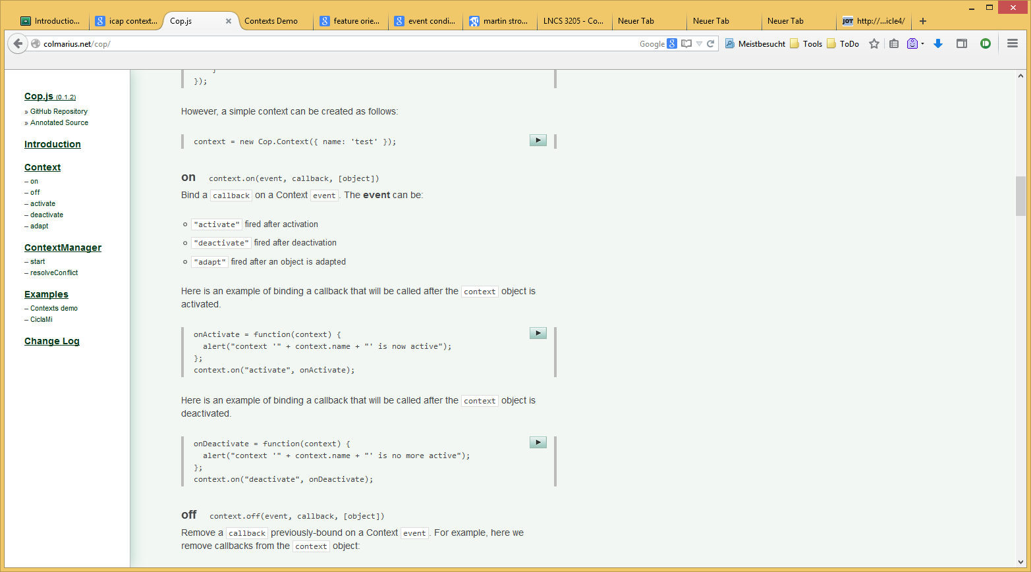
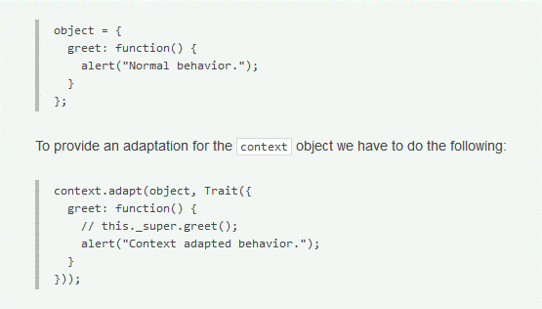
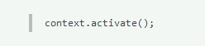
COP.js

Slide 50
COP extensions/frameworks
ContextS
ContextS2
ContextJS
JCop
ContextJ
ContextPy
PyDCL
UseCasePy
PyContext
ContextR
ContextG
Subjective-C
Context Petri Nets
ContextAmber
ContextL
ContextScheme
ContextJ
ContextErlang
EventCJ
Lambic
Ambience
COP.JS
delMDSCO
cj
Phenomenal Gem

Slide 51
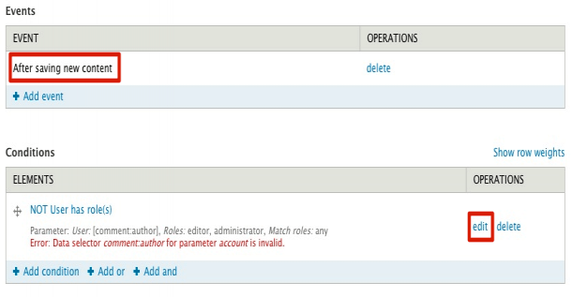
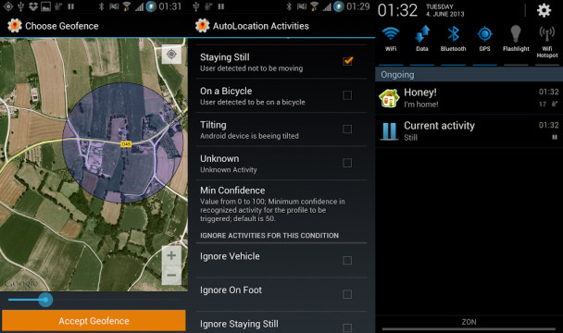
Event Condition Action

Slide 52
Interactive Prototyping of Context Aware Applications (iCAP, Dey 2006)

Slide 53
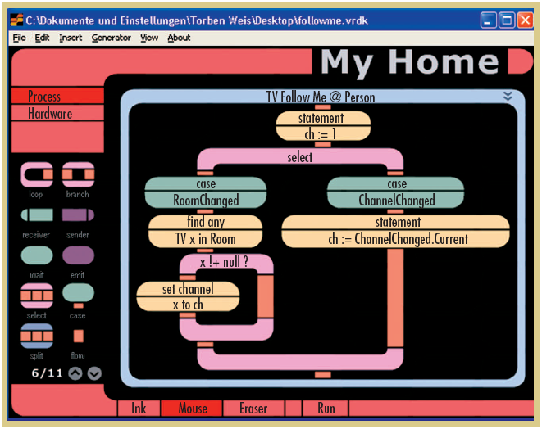
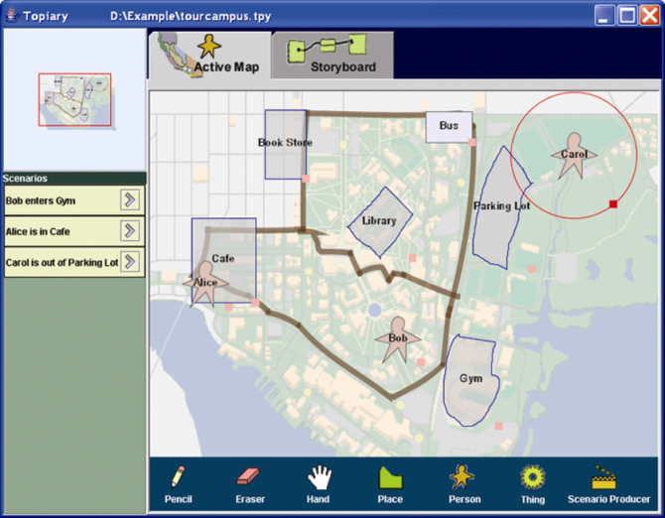
Rapid Prototyping
For Programmer
VisualRDK (visual language for smart spaces)
Topiary (for location-aware prototypes)
VisualRDK
Topiary

Slide 54
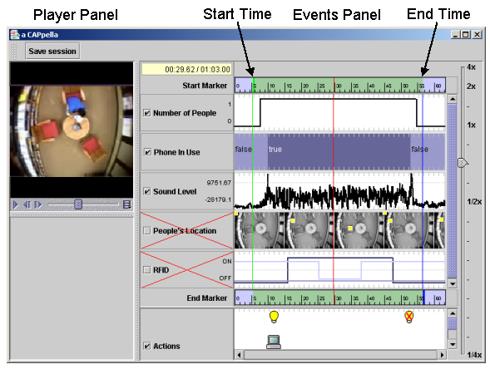
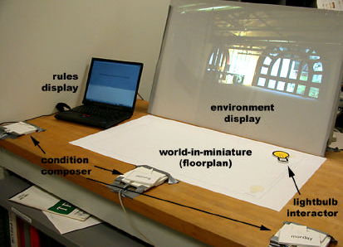
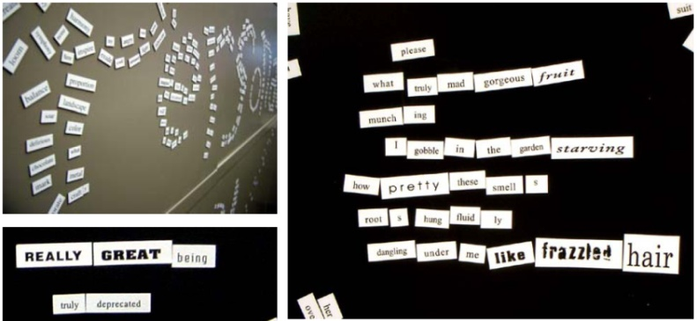
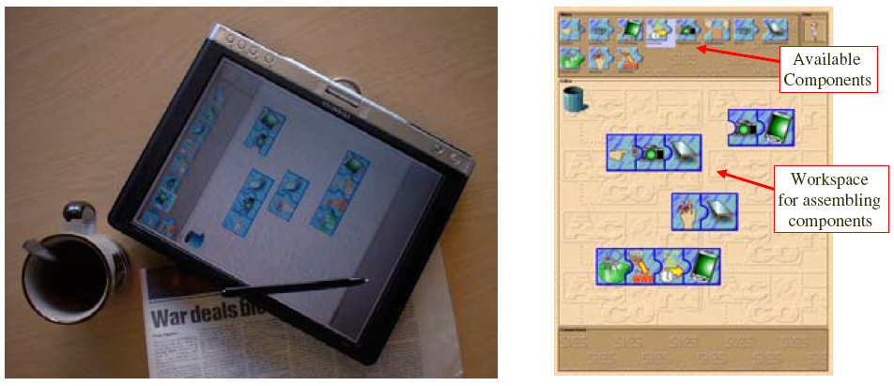
Rapid Prototyping
For End-User
CAMP (keyword combination)
aCAPpella (demonstration)
Playing with the Bits (graphical editor)
SiteView (miniature based)
aCAPpella
Playing with the Bits
SiteView
CAMP

Slide 55
Logic programming

Slide 56
Logic Programming

Slide 57


Slide 58
Reading
Helal, Sumi. "Programming pervasive spaces." Pervasive Computing, IEEE 4.1 (2005): 84-87.

Slide 59
Sources
LiveContexts (Bringing adaptability to the heart of software-intensive products): https://released.info.ucl.ac.be/projects/varibru/solution.html
Recent Developments in Context-Oriented Programming (Robert Hirschfeld, 2015)
Configuration of Smart Environments made Simple (Simon Mayer, IoT 2014)
A Survey on Ubicomp Research (M.Lee)

